Slide 1
ORL 5524-Session 2.0
Instrument Design and Validation
Madhabi Chatterji, Ph.D.
Professor of Measurement, Evaluation and Education
Director, Assessment and Evaluation Research Initiative (AERI)
Teachers College, Columbia University

Slide 2
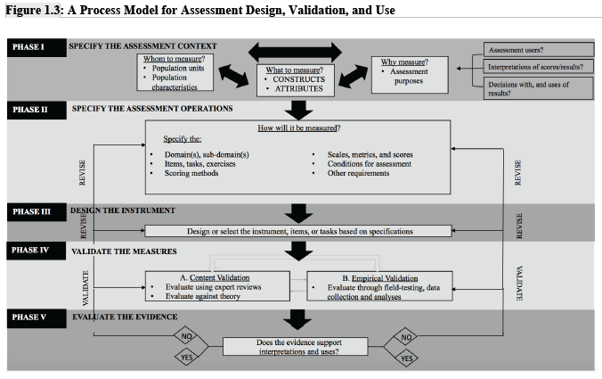

Slide 3
AGENDA
THINKING ABOUT-
Homework exercise and readings
Measurement Scales –categories, types, properties
Construct Measures and Units of Analysis
Validation
  Validity, Reliability and Utility
  Theoretical foundations of instrument design and validation- unitarian and trinitarian views
  Classical Test Theory (CTT), domain sampling theory as a part of CTT
  Applying various psychometric and other analyses to evaluate scores

Slide 4
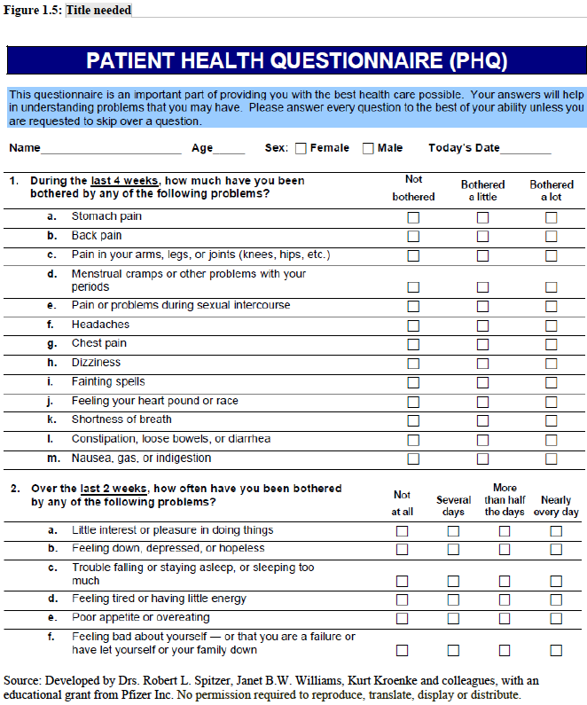

Slide 5
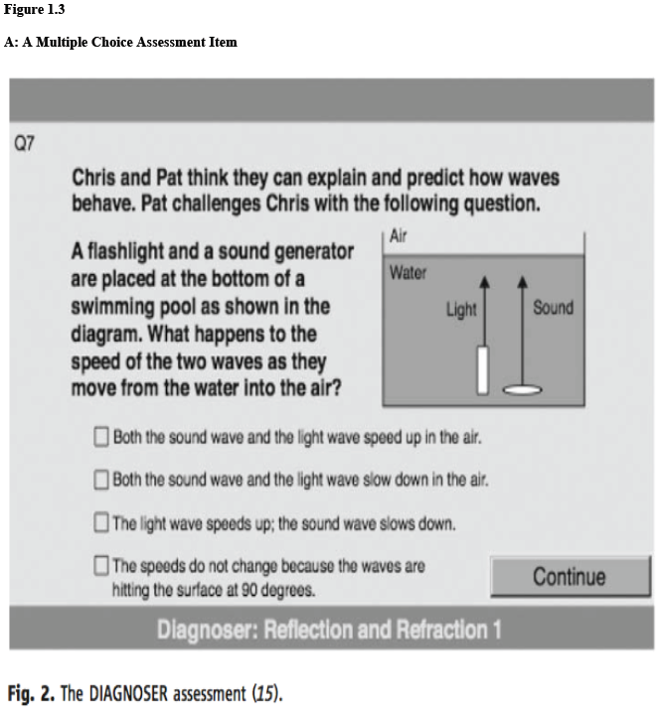

Slide 6
How we assess-
How? Assessment Operations—common assessment methods and modalities (Chapter 4, Chatterji, 2003)
  Multiple choice (structured response) tests
  Constructed-response tasks and essay assessments
  Portfolio-based assessments*
  Product-based assessments*
  Behavior-based and performance assessments*
  Interview-based assessments*
  Survey-based scales—e.g., attitude scales, self-reported or other-rated inventories*
  * Falls under “Performance Assessments”
  ALL must incorporate scoring protocols or rubrics, that yield a “scale” which yields numeric data

Slide 7
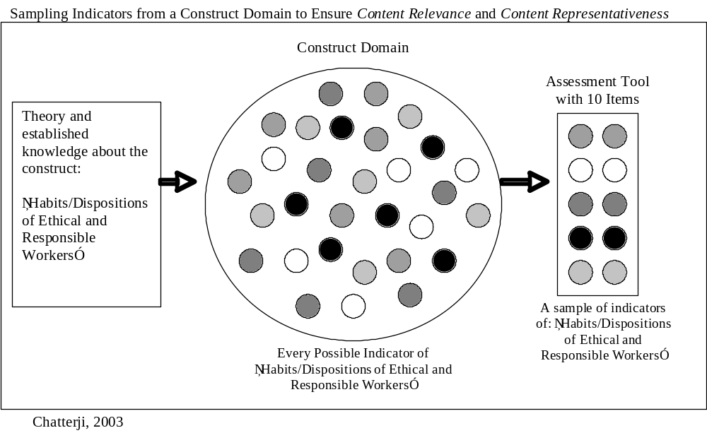
Designing instruments and scales using a domain sampling approach

Slide 8
Before Validation: Clarify purposes!
Multi-purposing assessments in different assessment contexts
What are the implications?
  Expanding inferences at different units of analysis
  Expanding uses
  Expanding or changing sub-populations or new populations

Slide 9
Why? Common Assessment Purposes
( Chapter 2, Chatterji, 2003)
Research and Science—Measurement is integral part of “doing research” in the quantitative sciences; helps expand knowledge about unknown constructs
Applied Decision-making in Practice and Policy Contexts
  Clinical assessment and diagnosis
  Classroom instruction, grading, educational decision-making
  Professional certification, selection, awards or recognition
  College admissions and entrance testing
  Institutional or program planning
  Program evaluation, accreditaton and accountability purposes
  Other?

Slide 10
Before Validation: Be Clear about Your Construct Measures and Units of Interest!
“X=T+E”
Are your measures of interest:
X = Raw scores (Sum of all numerically coded item responses for individuals?)
X =Derived scores (Scores or measures derived from the raw score using a statistical or psychometric procedure?)
X =Composite scores (Sum of scores or measures from more than one instrument scale/sub-scale, or data source?)
X =Aggregated or “Group” Scores (Means of scores or aggregated measures from more than one individual in a group or organizational unit?)

Slide 11
Validation - Quality Criteria for Assessments and Constructs Measures ( Chapter 3, Chatterji, 2003)
Validity (Construct Validity)
  To what degree are the construct measures meaningful? Evaluated in the assessment use context, vis-à-vis the construct(s) of interest, in the population units specified, and for the specific inferences and assessment purposes intended by primary users.
  Validation: An evidence-based evaluation of how well construct measures permit the specific inferences about the construct in the targeted contexts of use (Phase IV-V)
    Systematic errors of measurements—usually predictable
Reliability
  How precise and consistent (replicable) are measures under different conditions
    Estimated precision of construct measures and “test scores”
    Random errors of measurement
Utility
  Usability and practicality of instrument and constructs measures for intended uses and users

Slide 12
Modern view: Validity and the Logic of Validation
“Validity”=“Construct Validity”-
Validity refers to the meaningfulness and defensibility of the measures ( scores) vis-à-vis the theory underlying the construct, for a
given population, for the specified purposes (inferences and uses, in a
specific research or applied context).
Basic assumptions of Classical Test Theory:
X=T+E
X= A person’s observed score on the construct
T= A person’s “true” score on the construct
E= Error associated with scores/measures
E =random (reliability) E=systematic (validity)

Slide 13
Examples - Systematic vs. Random Error (all fixable during design)
English language barriers of particular groups of students when taking a achievement or ability test (Likely: Systematic error! Validity Issue)
Wavering focus or distractedness of respondents (Likely: Random error! Reliability Issue)
Inaccessible assessment modality or presentation format for some respondents (Likely: Systematic error! Validity Issue)
Too short a test or survey—too few or very small “sample size” of items or behaviors from the domain (Likely: Random error! Reliability Issue)

Slide 14
Construct Validation—A Unitarian View (after AERA, APA, & NCME, 1985; 1999; 2014)
“ Unitarian” View of Validation -
Systematic methods for gathering and evaluating a body of evidence in a unified manner to better understand the properties of the scores or measures, evaluate what they mean, and assure their defensibility
for the intended interpretations and uses in the specified context
Because there is always error associated with the scores or construct measures generated by instruments, we gather/evaluate relevant kinds of evidence to ensure the psychometric quality and utility of measures. There is a knowledge base and a range of psychometric evaluation procedures that we can draw on to conduct studies to verify:
item and scale properties and overal quality
validity evidence on scores/ construct measures in contexts of use
reliability of scores/construct measures
An overall and comprehensive evaluation!

Slide 15
Traditional View: Trinitarian
Prior, “ Trinitarian” View of Validation -
Different types of instruments require different types of validity evidence. Based on the major classes of instruments in use, there are three “aspects” to validity (or types of validity specific to the type of instrument) :
Content validity: Do the items reflect what the construct is about ( in theory) and can this be validated by experts?
Applies to achievement and ability tests only
Predictive validity: Do the “scores” or “measures” predict some future criterion or outcome behavior, as expected?
Applies to tests of aptitude or clinical placement assessments (test used to diagnose and treat clients or patients)
Construct validity: Do the “scores” or “measures” measure the psychological construct well, per the underlying theory?
Applies to all psychological tests and assessments.
Why Criticisms ???

Slide 16
Validity and the Logic of Validation
Logic of Validation-
“What” question: Are the scores/measures meaningful with respect
to the construct(s) we intended to tap?
“Why” question: Are the scores precise and meaningful enough for
our intended interpretations*, purposes* and decision-making needs?
“Whom” question: Are the scores consistent in
meaning for all members and sub-groups in the target population?
If we want to minimize errors, the What, Why, and Whom questions matter before we jump into designing or selecting an instrument!
*Score-based inference or interpretation vs. use

Slide 17
Summary- Your Takeaways?
We tap construct(s) through assessment instruments we design or select, for particular populations and purposes.
Instruments are made up of samples of items, tasks from a defined domain that represents the construct
The instruments help us elicit and gather responses (from members/units in our target population) can be scored numerically and yield a “scale”. The “observed scores” have particular scale properties (nominal, ordinal or interval, typically)
There is always some degree of error in the scores, so we subject the instrument to a series of evaluations and quality assurance checks. This process of evidence gathering to gauge and certify the quality of measures for the intended purposes and populations, is called validation.
We attack the assessment design process by specifying the construct(s), purpose(s) in terms of measure-based inferences and uses, and the population first. Then we follow a specifications-driven process to design and validate the tool and the measures it yields.

Slide 18
Types of Validity Evidence
COMMON KINDS THAT WE SHOULD LOOK FOR:
Content-Based Validity- Is the content of the items a true match with the theory about the construct? Expert review, CVI or content validity indices based on agreements.
Correlational Evidence of Validity
  Convergent Validity Evidence– Do the scores overlap or correlate as expected with other, similar measures? Empirical Correlational Studies
  Discriminant Validity Evidence--Do the scores NOT overlap or correlate with dissimilar measures, per theory? Empirical Correlational Studies
  Criterion-related Validity Evidence- (e.g., Predictive Validity)—Do the scores predict some future behaviors, as per the construct theory? Empirical Correlational Studies
  Evidence of Internal Structure- are the patterns of responses to items fit the conceptual structure of the construct? Empirical “Factor Analysis” Studies and other Methods
Controversial notion-“Face Validity”—Do respondents and test-takers believe the instrument measures what it says it does? Not considered a “true” kind of validity evidence, but useful to investigate sometimes

Slide 19
Types of Reliability Evidence
Common methods for gathering data and estimating reliability are based on Pearson correlations (r)
  Test-retest reliability. Do scores remain stable over short periods of time (about 2 weeks)? .
  Parallel-forms reliability. Are scores from parallel test/assessment forms of same domain, consistent, interchangeable and replicable?
  Inter-rater reliability. Do scores remain consistent with different observers or raters—applied to performance or observational assessments?
  Internal consistency reliability. Do individuals respond consistently to items from the same domain?
    Cronbach’s alpha reliability
    Split-half reliability
  In all, r of 80- .90 or better is good, less than .70 is questionable. Should not be below.60. Gathering reliability evidence is all included as a part of construct validation under the unified view of validity.
AERA, APA & NCME, 2014

Slide 20
Validation Plans—A Unified Approach
Homework/Practice
Think about your own instrument.
Follow the Process Model to specify the assessment context (Construct(s), population and units, the measure-based inferences and specific uses you intend, units of analysis)
Create a draft of a validation plan using the “Unitarian” framework

